Slide 1


Final Project Presentation
Comp 3710: Artificial Intelligence Concept

Slide 2

Topic
Game of Chess : Saber

Slide 3



Developed by
Chahak Patel
Misha Patel
Kenil Chovatiya

Slide 4

Content
Introduction
Objective
Basic concepts & Algorithms
Bug fixing and evaluation
Conclusion
Further improvements

Slide 5

Introduction
According to us Artificial Intelligence in current time is vast. There were so many ideas to choose for our project. It is like big world with advanced knowledge. Every ideas of project we investigated needs unique learning and knowledge with unique skills required for implementation.
The game of chess is famous, and, for improved expertise of this game, we tend to implement a decent computer science system that may offer competition to humans and create the sport of chess a challenging task

Slide 6

Objective
The main idea behind this project was simple. It gives real-time challenges like how our AI will work according to every move played by a real player, as there are so many outcomes to win the game of 64 blocks.
Every agent in the game has their unique steps. For example, a queen in chess can go in any direction and move accordingly. Primary concept is to implement agents of chess and in how many ways they can make moves.

Slide 7

Basic Concepts & Algorithms
Move-generation & Board evaluation
Position evaluation
Minimax Algorithm
Alpha-Beta pruning

Slide 8

Move-generation & Board evaluation
We developed the project using java scripting and jQuery’s and html-CSS for creating board and design. We used chess.js library for move generation and chessboard.js for visualization of board.
The chess move generation library practically defines all the game's rules. We then computed all legal movements for a given board state using this information.
Next step is to implement the algorithm that finds the best move, in simple word position evaluation.

Slide 9
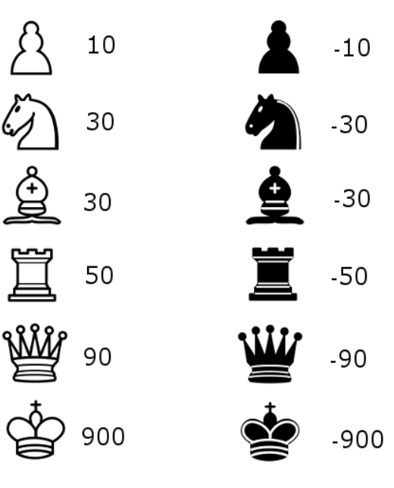
Position evaluation
The key goal of role assessment is to determine which side is more powerful in each situation. The easiest method is to use the table to count the relative power of the pieces on the board ( you can see the image).
We will use the evaluation function to construct an algorithm that selects the step with the best evaluation.
The only modification is that our algorithm can now grab a piece if it is feasible.

Slide 10
Minmax Algorithm
The next step was to construct a search tree from which the algorithm could select the best course of action. The Minimax algorithm is used to do this.
The recursive tree of all potential moves is explored to a given depth in this algorithm, and the location is evaluated at the tree's ending "leaves.“
After that, based on whether it's a white or black to pass, we return the child's smallest or largest value to the parent node. (In other words, at each step, we aim to decrease or increase the outcome.)

Slide 11
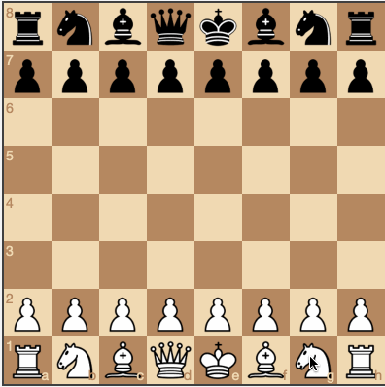
Our algorithm is beginning to learn some simple chess strategy now that minimax is in place.
The search depth we can reach determines how efficient the minimax algorithm is. We enhanced this in the next step, which is Alpha-beta pruning.
You can see the gif of how it is working.

Slide 12
Alpha-Beta pruning
Alpha-beta pruning is a minimax algorithm optimization technique that helps one to ignore certain branches in the search tree. This allows one to go deeper into the minimax search tree while still using the same tools.
The minimax algorithm's result is untouched by alpha-beta pruning; it is making faster. If we visit the paths that lead to successful moves first, the alpha-beta algorithm is also more effective.
So, alpha- beta is used to make move made by computer smoother and more effective.

Slide 13
Bug fixing and evaluation
We just count the content that is found on the board, so the initial measurement function is very naive.
To boost this, we have a dimension that considers the location of the pieces in the assessment.
A knight in the middle of the board, for example, is stronger than a knight on the board's edge (because it has more choices and therefore is more active).
With the next enhancement, we begin to get an algorithm that plays some “decent” chess, at least from the perspective of a casual player.

Slide 14

Conclusion
Even a simplistic chess-playing algorithm has the advantage of not making dumb errors. Nonetheless, it loses strategic understanding.
We were able to design a chess-playing algorithm that can play simple chess using the methods we provided here. The final algorithm's "AI-part" (move generation excluded) is only 200 lines of code, implying that the basic principles are easy to apply.

Slide 15
Further Improvements
As we know there is large amount of moves in chess changing per player.
Some further improvements that we could work on in future are:
Move ordering
Fast generation of moves
Timer for specific move
And end game specification

Slide 16

Thank You

